Slide 1
Decision Making

Slide 2
If statement
C if Statement
The syntax of the if statement in C programming is:
if (test expression)
{
// statements to be executed if the test expression is true
}

Slide 3
Example
/*Program to display a number if it is negative*/
#include <stdio.h>
int main() {
int number;
printf("Enter an integer: ");
scanf("%d", &number);
if (number < 0) {
printf("You entered %d.\n", number);
}
printf("The if statement is easy.");
return 0;
}

Slide 4
C if...else Statement
The if statement may have an optional else block. The syntax of the if..else statement is:
if (test expression) {
// statements to be executed if the test expression is true
}
else {
// statements to be executed if the test expression is false
}

Slide 5
Example
/* Check whether an integer is odd or even*/
#include <stdio.h>
int main() {
int number;
printf("Enter an integer: ");
scanf("%d", &number);
if (number%2 == 0) {
printf("%d is an even integer.",number);
}
else {
printf("%d is an odd integer.",number);
}
return 0;
}

Slide 6
How if...else statement works?
If the test expression is evaluated to true,
statements inside the body of if are executed.
statements inside the body of else are skipped from execution.
If the test expression is evaluated to false,
statements inside the body of else are executed
statements inside the body of if are skipped from execution.

Slide 7
C if...else Ladder
The if...else statement executes two different codes depending upon whether the test expression is true or false. Sometimes, a choice has to be made from more than 2 possibilities.
The if...else ladder allows you to check between multiple test expressions and execute different statements.

Slide 8
Syntax
if (test expression1) {
statement(s)
}
else if(test expression2) {
statement(s)
}
else if (test expression3) {
statement(s)
}
.
.
else {
statement(s)
}

Slide 9
#include <stdio.h>
int main() {
int number1, number2;
printf("Enter two integers: ");
scanf("%d %d", &number1, &number2);
if(number1 == number2) {
printf("Result: %d = %d",number1,number2);
}
else if (number1 > number2) {
printf("Result: %d > %d", number1, number2);}
else {
printf("Result: %d < %d",number1, number2);
}return 0;
}

Slide 10
Write a program to check whether the given integer is positive even, negative even, postitive odd or negative odd.
Write a program to check whether a percentage score of an student is Distinction, first division, second division, third division or fail.

Slide 11
Nested If
Syntax
The syntax for a nested if statement is as follows :
if( boolean_expression 1)
{ /* Executes when the boolean expression 1 is true */
if(boolean_expression 2)
{ /* Executes when the boolean expression 2 is true */ }
}

Slide 13
Nested if...else
It is possible to include an if...else statement inside the body of another if...else statement.

Slide 14
#include <stdio.h>
int main() {
int number1, number2;
printf("Enter two integers: ");
scanf("%d %d", &number1, &number2);
if (number1 >= number2) {
if (number1 == number2) {
printf("Result: %d = %d",number1,number2);
}
else {
printf("Result: %d > %d", number1, number2);
}
}
else {
printf("Result: %d < %d",number1, number2);
}
return 0;
}

Slide 15
Switch statement
Switch statement in C tests the value of a variable and compares it with multiple cases. Once the case match is found, a block of statements associated with that particular case is executed.
Each case in a block of a switch has a different name/number which is referred to as an identifier.

Slide 16
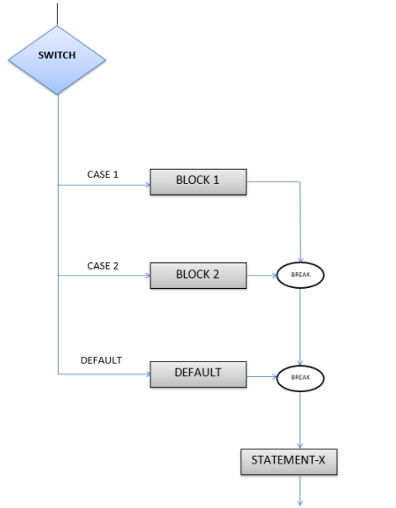

Slide 17
Example
// Program to create a simple calculator
#include <stdio.h>
int main() {
char operator;
double n1, n2;
printf("Enter an operator (+, -, *, /): ");
scanf("%c", &operator);
printf("Enter two operands: ");
scanf("%lf %lf",&n1, &n2);
switch(operator)
{
case '+':
printf("%.1lf + %.1lf = %.1lf",n1, n2, n1+n2);
break;
case '-':
printf("%.1lf - %.1lf = %.1lf",n1, n2, n1-n2);
break;
case '*':
printf("%.1lf * %.1lf = %.1lf",n1, n2, n1*n2);
break;
case '/':
printf("%.1lf / %.1lf = %.1lf",n1, n2, n1/n2);
break;
// operator doesn't match any case constant +, -, *, /
default:
printf("Error! operator is not correct");
}
return 0;
}

